Slide 1

Shush App
By Team AuRave:
Aaron Turner and Kumin In

Slide 2
Introduction
Shush was developed to be a secure end-to-end encrypted group messaging application
For the client, we used Angular 2 and Ionic 2 Beta 11
For the Backend, we used Express and Node.js
For the Database, we used MongoDB

Slide 3
Database

Slide 4
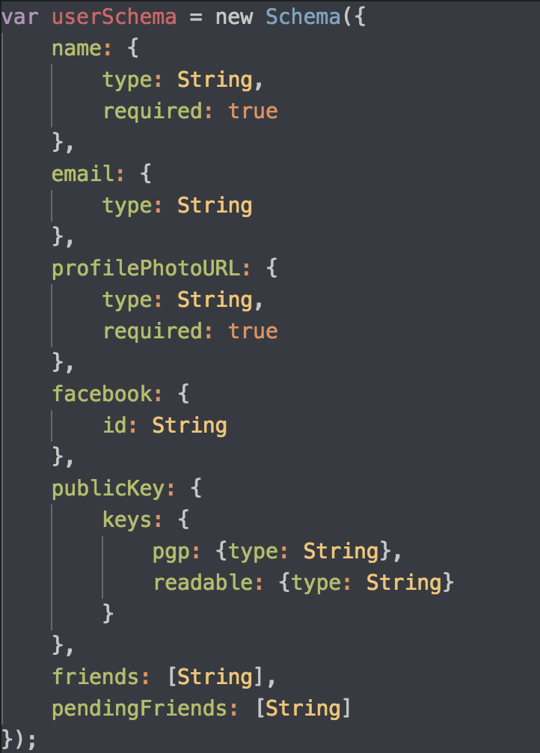

Slide 5
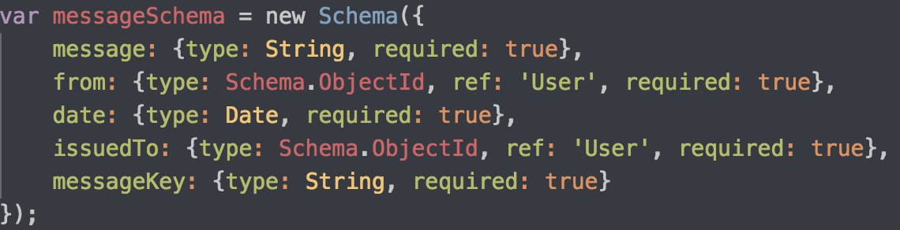
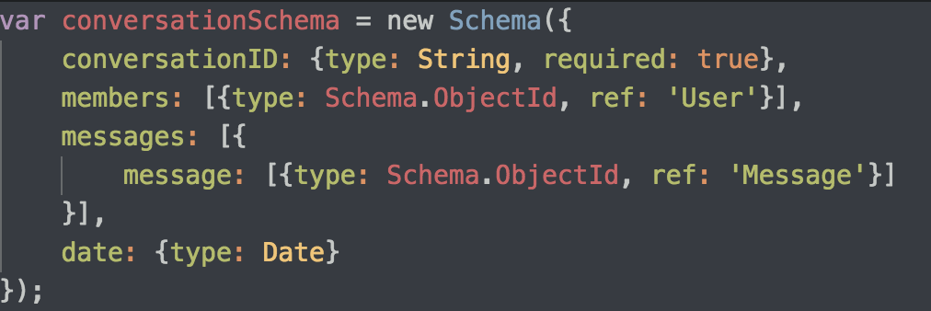

Slide 6
Backend

Slide 7
REST API Endpoints
POST /api/v1/login
Endpoint for logging in.
GET /api/v1/user/publicKey/:id
Route for getting any user’s public key.
PUT /api/v1/user/publicKey
Route for setting the public key of the user.
GET /api/v1/user/:id
Route for getting a user based on their facebook id.
GET /api/v1/user
Route for searching users based on query.
GET /api/v1/user/friend/get
Route for getting the list of friends and pending friends for the user.

Slide 8
REST API Endpoints (Continued...)
PUT /api/v1/user/friend/delete
Route for deleting a friend.
PUT /api/v1/user/friend/accept
Route for accepting a pending friend request.
PUT /api/v1/user/friend/decline
Route for declining a pending friend request.
PUT /api/v1/user/friend/add
Route for creating a friend request.
GET /api/v1/conversation
Route for getting the whole conversation
PUT /api/v1/conversation
Route for updating the whole conversation.
POST /api/v1/conversation
Route for creating a new conversation with friends.

Slide 9
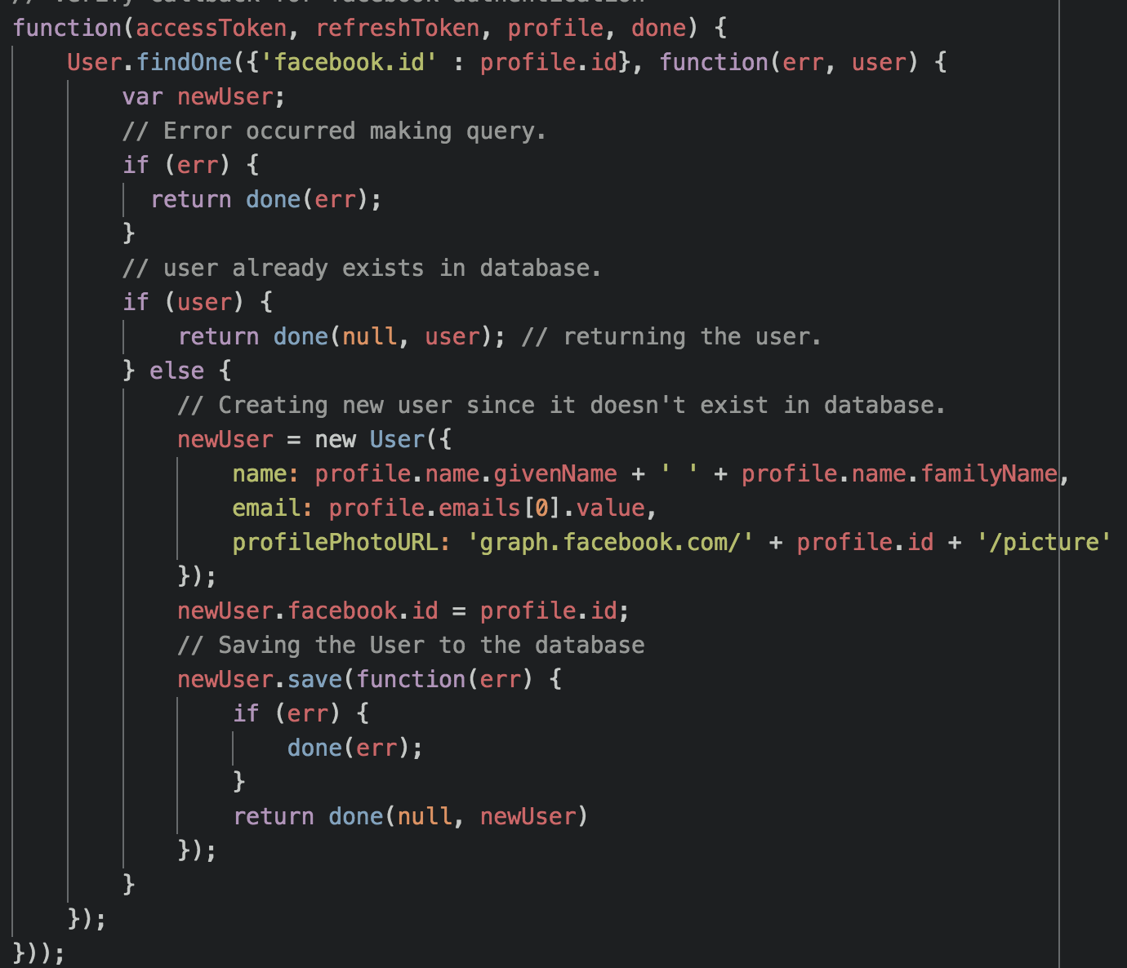
The Backend
Handles all routes requested to the specified API endpoints.
Handles CRUD operations for Messages, Users, and Conversations.
Create the data
Read the data
Update the data
Delete the data
Created using Node JS, Express JS, and Passport JS.
Example for creating a user if the user doesn’t exist.

Slide 10
Client

Slide 11
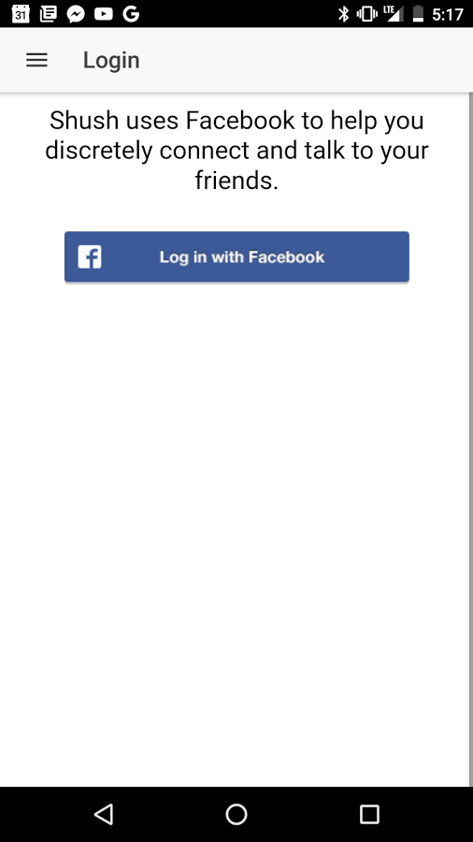
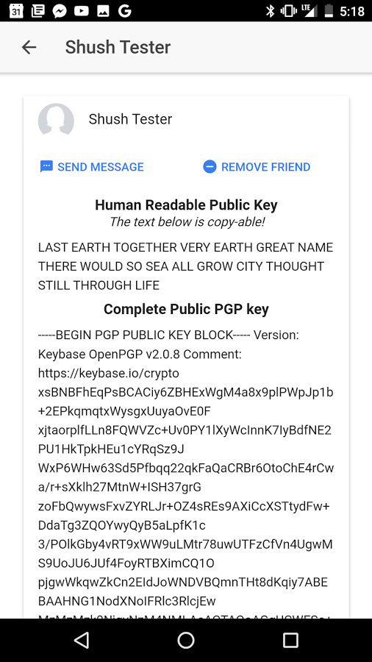
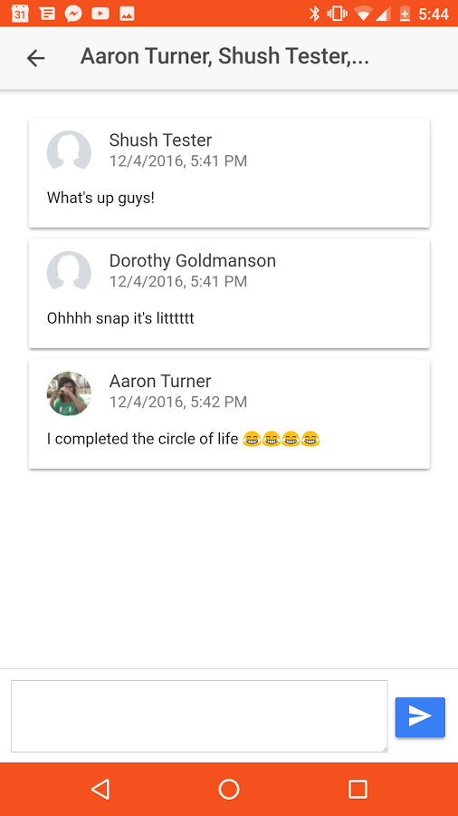
Client Application

Slide 12
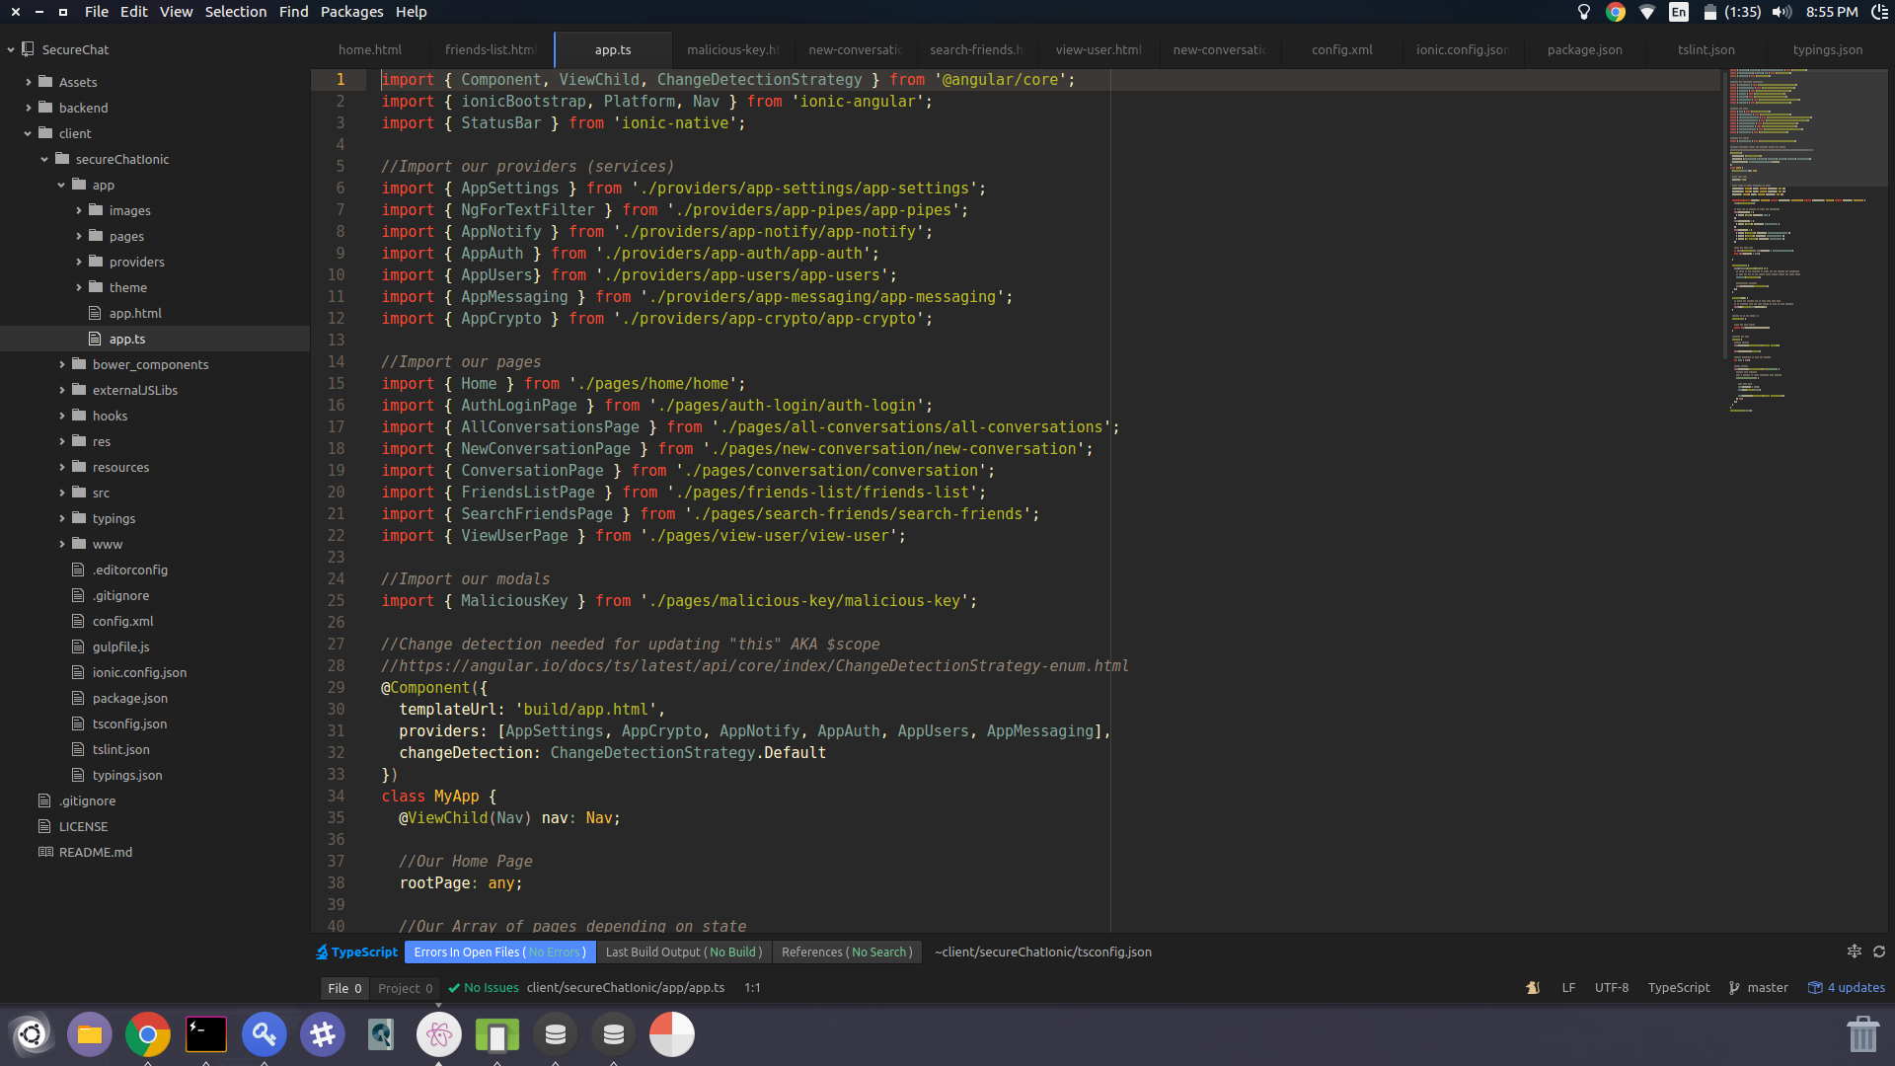
Client Application (Continued...)
The Client Application handles Server Requests, and encryption.
It is build in Ionic v2, but uses libraries, such as Animate.css, to look pleasing to users!

Slide 13
Authentication

Slide 14
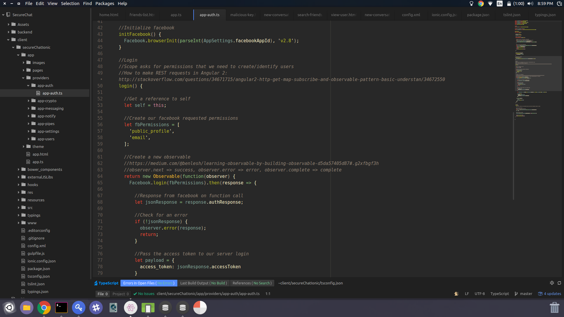
Authentication
We used facebook Native OAuth Apis to authenticate our users, using Facebook Access Tokens

Slide 15
Encryption

Slide 16
Encryption
We used CryptoJs and KbPGP to handle encryption on the client.
On Account Creation, a public pgp key, a private pgp key are generated. The public pgp key is stored on the server.
Also, we create a public key store and private key store, for caching keys. The generated private pgp key is stored in the private key store for each user on the device.

Slide 17
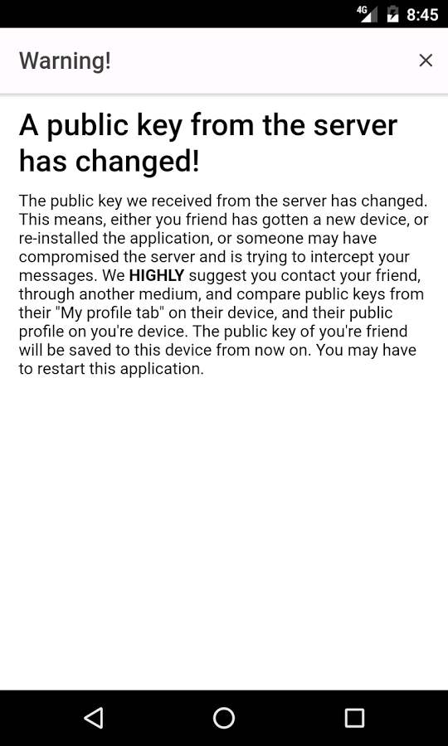
Encryption (Continued...)
Whenever a device GETs another user, their key is stored in the public key store. If the keys ever mis match, a warning is shown.

Slide 18
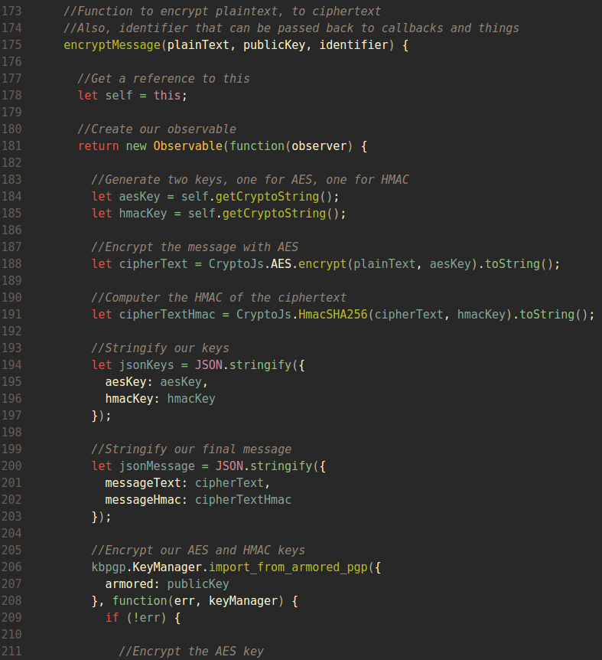
Encryption (Continued...)
Messages sent are Encrypted with Unique AES Keys. These keys are then Encrypted with a public PGP key. On receive, the private PGP key decrypts the keys, to decrypt the message.
P.S We use also use HMAC SHA256!

Slide 19
Demo Time!!

Slide 20
Cost?

Slide 21
How Much Does Something like this cost?
The average Node.js/Javascript developer in the Los Angeles area makes approximately $44/hr.
Kumin and I started the project around Week 3 of 15 of the semester.
We approximately worked between 4-8 hours per week, and about 30 in the last week.
That gives about 80 hours per developer
102 hours * 2 developers * $44/hr = $8,976
Each developer could have paid tuition for an entire semester at CSULB, books for that semester, and a new PC Laptop.
*Based on CSULB tution costing ~$6,452/yr, books costing ~250, new laptop costing ~$800.

Slide 22
Question?

